Slide 1
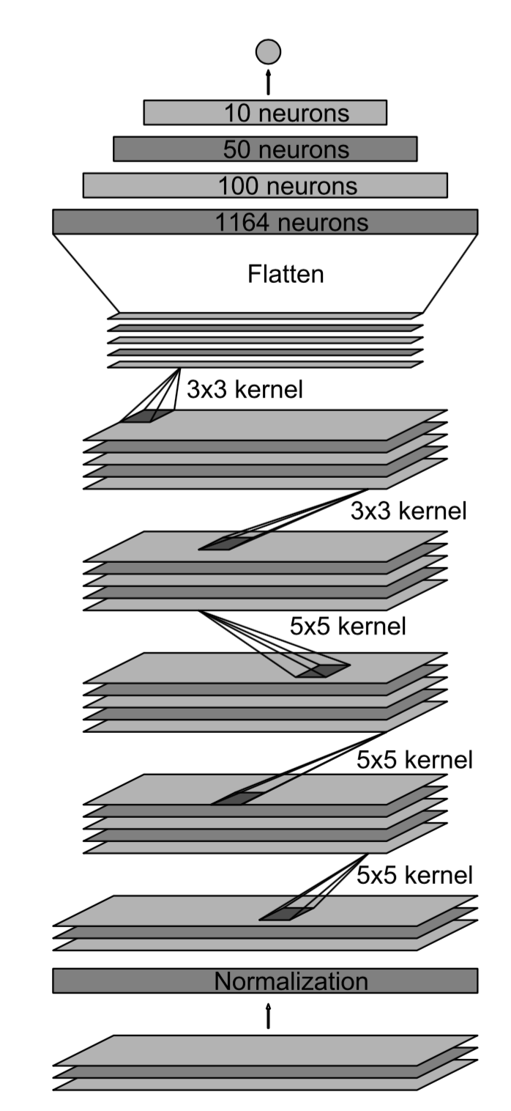
Output 1
Fully connected 10
Fully connected 50
Fully connected 100
Flatten 1792
Dropout (0.5)
Conv2D 64@1x28, activation RELU
Conv2D 36@32x64, activation RELU
Maxpooling 48@9x36
Conv2D 48@18x73, activation RELU
Maxpooling 36@22x77
Conv2D 36@44x154, activation RELU
Maxpooling 24@48x158
Conv2D 24@96x316, activation RELU
Normalization 3@100x320
Input planes 3@160x320

Slide 2
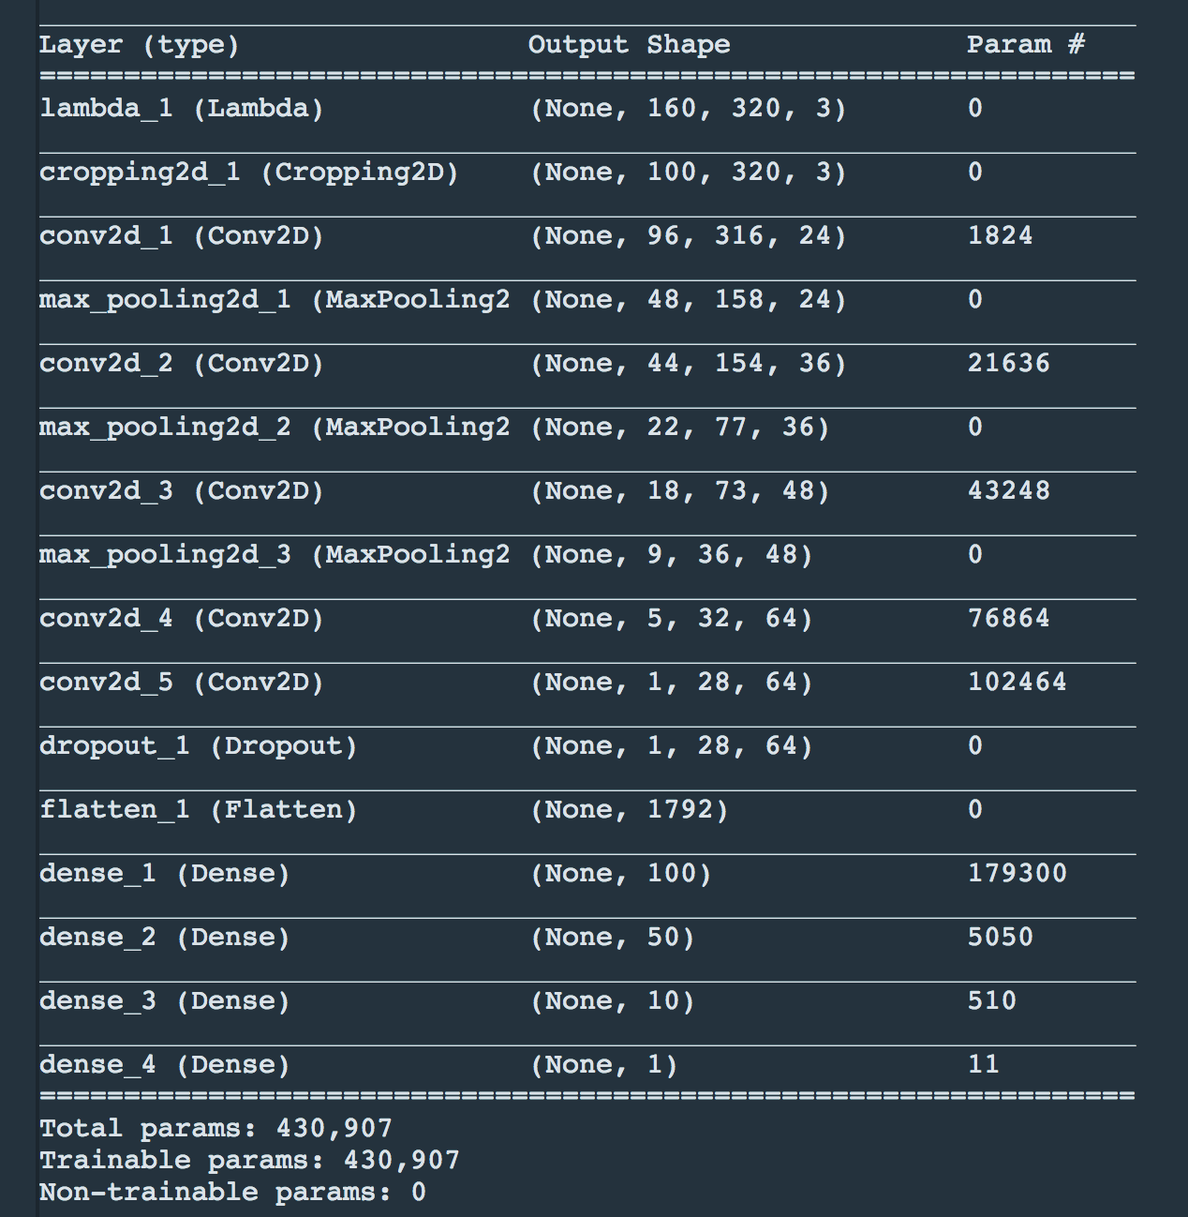

Slide 3
